Slide 1
Notas de aula
Introdução à Física Computacional
Prof. Gerson – UFU – 2019
Atendimento:
  Sala 1A225
  Email: gersonjferreira@ufu.br
  Webpage: http://gjferreira.wordpress.com
  Horário: sextas-feiras 16:00 – 16:50

Slide 2
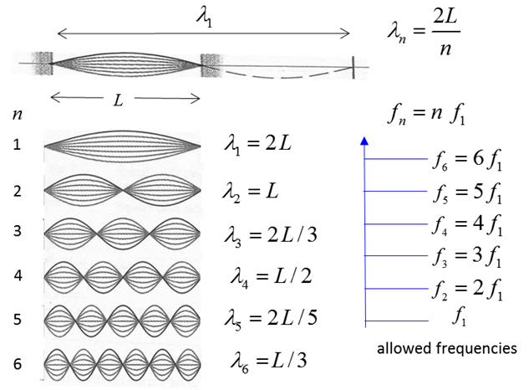
Boundary value problems
wave-equation
Fourier t → w
as an eigenvalue problem

Slide 3
Finite differences
Consider a function f(x) on a discrete lattice
The N points are set as
and size L
...
This give us →
The Taylor expansions of f(x ± Δx) for Δx → 0 are

Slide 4

Finite differences
Matrix representation of d²/dx²
Add the Taylor expansions from
the previous page, to obtain
...
Apply rule for n=1 .. N (inner points)
It takes a matrix form
vanishing boundary conditions:

Slide 5

Finite differences
Matrix representation of d²/dx²
Add the Taylor expansions from
the previous page, to obtain
...
Apply rule for n=1 .. N (inner points)
It takes a matrix form
vanishing boundary conditions:

Slide 6
Homework
Find the matrix representations of the 1st derivative
considering:
a) the forward form of the finite differences
b) the backwards form
c) the symmetric form
In all cases, consider also the boundary conditions:
i) vanishing boundary condition (like in the previous slide)
ii) periodic boundary conditions: x_{N+1} = x₁, and x₀ = x_{N}
Also… apply the periodic boundary conditions to the 2nd derivative

Slide 7

The wave-equation in 1D
Already considering the Fourier transform t → w
Representing y(x,w) → y (x_{n}, w) on a discrete lattice

Slide 8
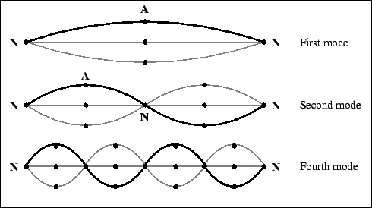

The wave-equation in 1D
Already considering the Fourier transform t → w
Representing y(x,w) → y (x_{n}, w) on a discrete lattice
… simplifying it
Use numpy.linalg to find the eigenvalues and eigenvectors

Slide 9
Plot the eigenvectors
Notice that the extreme points are missing: x₀ and x_{N+1} → boundary conditions
Tip! Use the numpy functions to build the matrix:
→ np.eye(…) → np.ones(…) → np.diag(…, k = {-1,0,1})

Slide 10
Wave-equation in 1D: time-evolution
What’s is behind the Fourier transform?
Assume φ_{n}(x) are the eigenvectors of -d²/dx² with eigenvalues α_{n} =(w_{n}/c)²
Ansatz:
← satisfies the wave-equation
At t = 0 the wave has an initial form →
(initial condition)
Fourier’s trick gives
animate!?

Slide 11

Schrödinger equation
The time-independent equation is identical to the wave equation after the Fourier transform
But let’s add a potential V(x)
Use:
The 2nd derivative has the same matrix representation as before, and V(x) is simply
Try it for:
Use vanishing boundary conditions

Slide 12
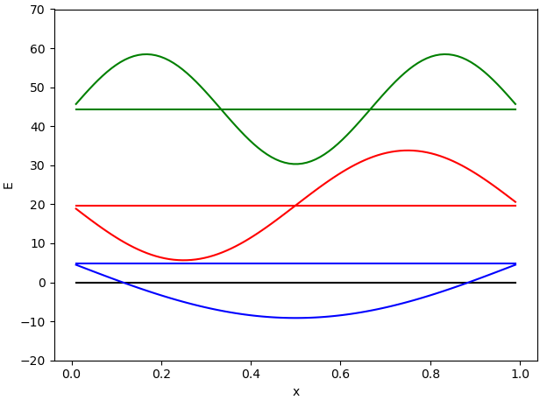
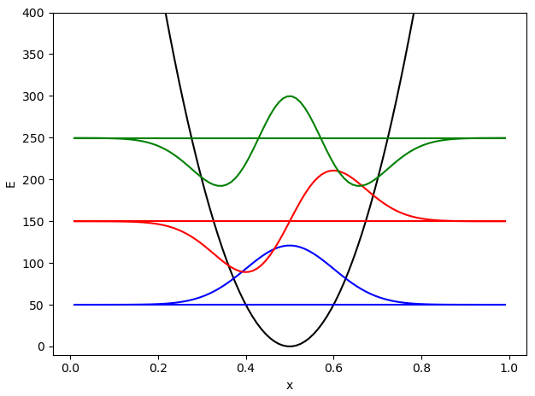
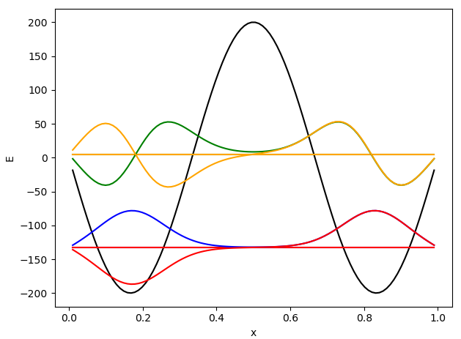
Schrödinger equation → solutions

